Slide 1
Product Development Lab
Group-4
Presentation-4
Carbon Chambers
Capturing Carbon, Saving Ecosystem!
Team Members:
20IM30010 Mohammed Fayiz Parappan
20IM30036 Biswa Ranjan Barik
20IM30020 Sneha Kumari
20IM30007 Janumpally Varun Aditya
20IM30013 Oindrila Maji

Slide 2
Purpose of Concept Testing
Internal
(Product Specific)
External
(Customer Specific)
Technical Feasibility
Confirm technology suits mobile CCUs
Market Validation
Target Audience
Competitive Landscape
Performance Validation
Environmental Evaluation
CUSTOMER & MARKET
Test CCU under real-world driving conditions
Assess carbon capture impact on surroundings
Risk Mitigation
Investor Confidence
User Experience Improvement
Energy Efficiency
Refinement of Regulation
Optimize power use for heavy vehicles
Ensure CCU complies with emissions standards
Concept testing ensures compliance, efficiency, eco-friendliness, performance, and technical feasibility for mobile carbon capture

Slide 3
Choosing a survey population of potential customers
Potential Customers for survey population:
Our Respondents
Fleet Operators-
commercial trucking companies, logistics providers, and transportation firms
Environmental and Sustainability Managers-
Individuals responsible for sustainability and environmental initiatives within organizations, including those in industries with significant carbon emissions
Government Agencies
Petrol Based Car Owners
Truck Manufacturers : Especially start ups. Tier 2 companies
Research and Development Teams
Investors and Venture Capitalists
BlackBuck - Trucking Network
Chanakya Hridaya - Co-founder - KGP Alum
Manish Singh - Chief Product Officer
Environmental Impact
Ananya Sudhir : Environmental Compliance Manager, Knight-Swift Transportation
Use Case
Harsh Jain - Founder, ,Carbon Strong, Carbon Utilization in Construction Tech -IIT R
Tushar Kanshal: Founder, Kansaltancy VC
XPO Logistics - Transportation Services
Rich Leonard - Director
Sonja Lawson- General Manager
Marten Transport
Charles Green - Fleet Manager
Joseph Reed - Operations Manager
Funding Scope
J. B. Hunt Transport
Eric Ervin - Vice President
Brandon Taylor - Sr. Vice President

Slide 4
Concept Communication
Participants were first given a detailed description of how the carbon capture technology would work if installed on their vehicle.
They were informed that the captured carbon would be converted to a solid state for easier storage and periodic removal.
2
4
1
3
This included an explanation of how a capture device would filter out CO2 before emissions leave the tailpipe.
They were also informed regarding the benefits they would get and the ones they would return to the environment.

Slide 5
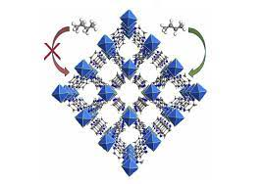

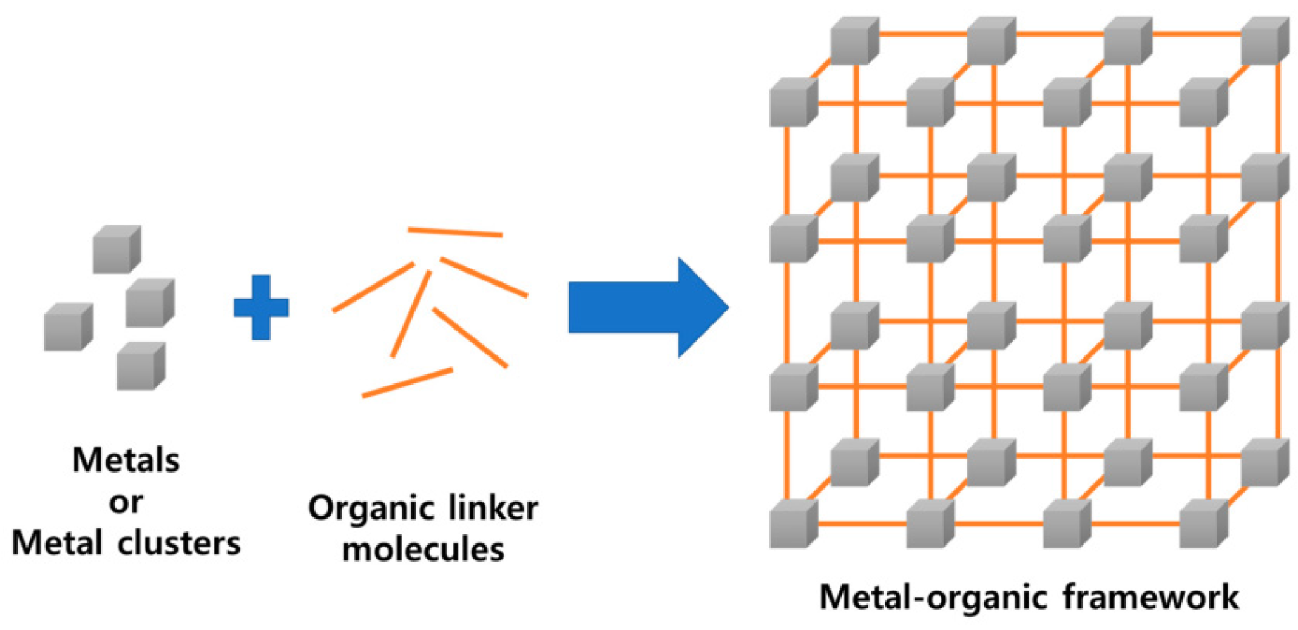
Product details
CARBON CAPTURE
Adsorption using KAUST-7
Fuel+Air
Combustion
Hot exhaust gases
Organic Rankine System
(Heat Exchanger)
Separation Process
- Desorption using heat from 5% hot exhaust gases making it more efficient design
- Releasing sorbent for another cycle of Carbon Capture
Heat
|
Mechanical
|
Electrical energy
92% CO2 Capture😎 efficient!!
CO2
Compression
CO2 Storage in tanks
Storage material -> Al-soc-MOF-1

Slide 6
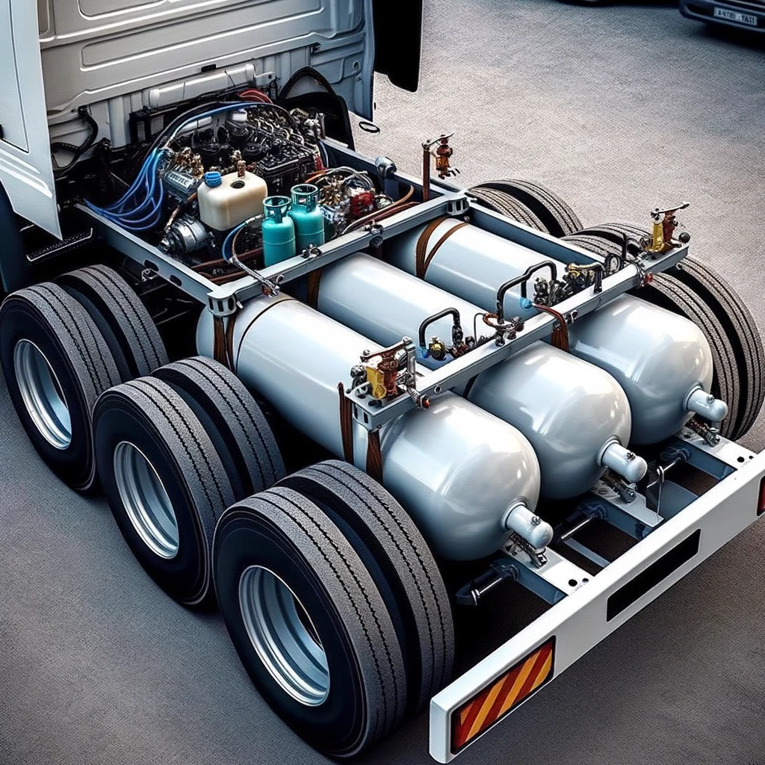
Product images
The cylinders in our proposed model are attached below the load which is different to existing CCS designs (attaching beside load).
This helps in easier and feasible recycling of CO2 capture which is released via the pipes connected to output knob of three cylinders similar to fuel refilling.
Initial sketch was perfected using DALLE-3 AI Technique

Slide 7
Measuring the customer response
Interest for this Zero Carbon Concept
Startups, MnCs showed huge interest
80%
Product Design & characteristics
Satisfied but could be improved
70%
Customer Need
In terms of immediate installation, fewer acceptance rate.
50%
https://www.cnbc.com/2022/06/28/why-companies-like-stripe-meta-and-alphabet-are-behind-carbon-removal.html
Financial Constraint
Stable companies interested to put the money
40%
Some Major Concerns and Possible Solutions:
3 respondents told that the size of storage tank can be small ( Possible solution- shorter offloading distance, points to keep in mind- it may lead to more offloading station, design- cost trade off)
Query about lead times and repairment policy - (got suggestions of backup cylinder and backup sensor, alarm of cylinder filling out)

Slide 8



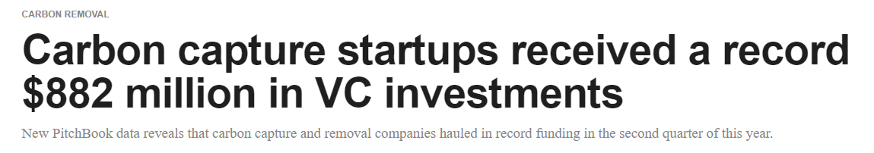
Measuring the purchase intention
Startup types | Purchase Interest | Remarks
Early stage |  | Low investment capability
Medium Scale |  | EV affordability is low, hence interested in low cost alternatives
Established firms |  | Heavy investment and marketing already done on EV. No interest in alternatives
https://www.protocol.com/bulletins/carbon-capture-venture-capital-investment
https://www.ventureradar.com/startup/Carbon%20capture

Slide 9
Suggestions from Respondants
01
Showed huge positive response. (Since, they cant afford EV directly due to higher initial investment).
Want to reduce carbon footprint( as sustainability is trending in current start up culture).
Bit cost sensitive, so want better pricing model.
Startup companies - Blackbuck, XPO, Marten, J.B.Hunt
02
Since initial customer acquisition would be less, it’s necessary to work on Marketing and creating awareness before large fundings.
Also suggested to make Pricing Model robust - Value based pricing
Venture Capital -
Kansaltancy - Funding Scope
03
Safety issues during CO2 transfer from uploading station to industries (could be hazardous process).
Networking with various industries needs to be done.
Industry specialized people -
Carbon Use in industries

Slide 10
Reflection on the Result & Recommendations
Results indicate there is an addressable market interested in this carbon capture technology, but costs will need to be low and education on vehicle integration will be critical for adoption.
Partnering with automobile makers to offer as a pre-install option on new vehicle models would likely drive broader consumer acceptance and willingness to pay a premium.
Marketing messaging should focus on ease of maintenance, fuel efficiency impacts, and overall effectiveness at reducing emissions.
More R&D is needed to bring down production costs and optimize integration with vehicles to overcome barriers identified in the concept test.

Slide 11
Reflection on the Result & Recommendations
CO2 discharge centers should be set up in every petrol pump which will let users dump CO2 and fill fuel simultaneously.
Benefit of each partner- Manufacturers, retailers, automobile companies, users, CO2 discharge centers should be emphasized and advertised to get more attention.
Safety trials with proposed CCS position below load should be tested in different conditions.

Slide 12
Thank You

